Slide 1
Introduction
to
Computer Architecture (Cont…)
Tapan Gandhi, IIT Delhi

Slide 2
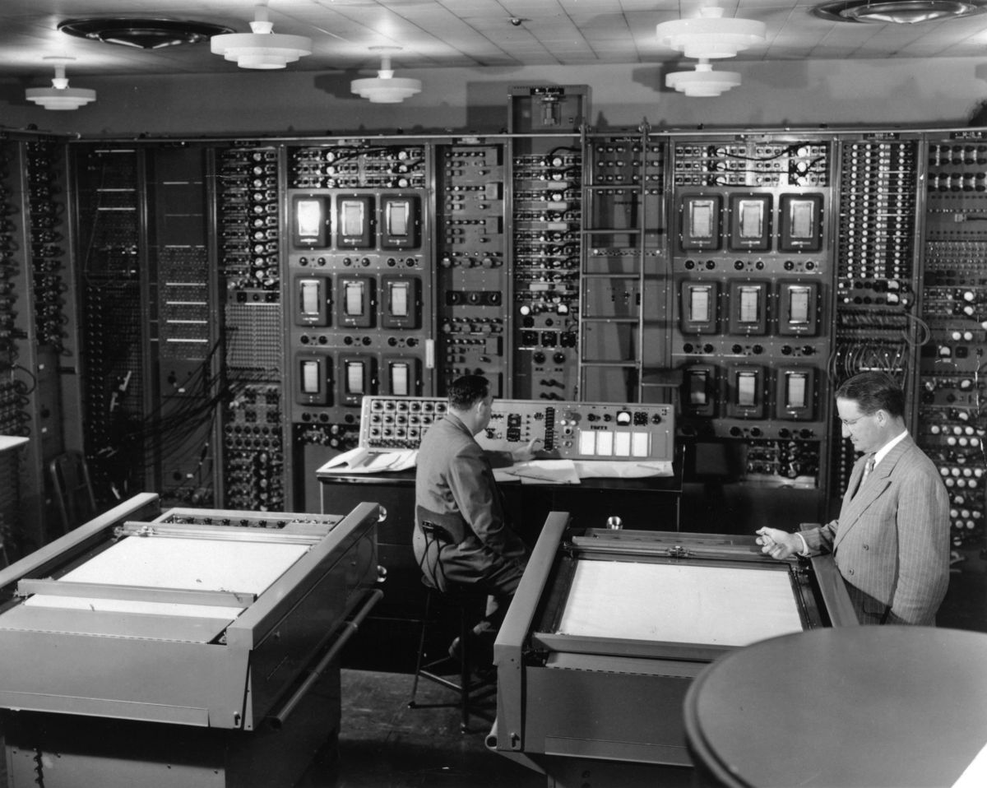
Computer, 1950

Slide 3

Computer, 2023
Notes:
today it packs in more power, more storage capacity, much more IO capabi lity than a typical computer

Slide 4

Computer, Future?

Slide 5
What is Computer Architecture ?
Answer : It is the study of computers
Computer Architecture
The view of a computer as presented to software designers
Computer Organization
The actual implementation of a computer in hardware.
5

Slide 6
Objectives:
Basic Principle, How computers work?
How computers are designed?
How to analyze their performance?
Issues with modern Processors
Notes:
w memory structures into caches and virtual memory and so on and how a operation could be pipelined and how instructions could be put in parallel so some of these modern concepts would be introduced. Of

Slide 7
Why are we interested to learn?:
Are we going to build a new computer?
-Rare opportunity
Design a new version of a computer
Improve software performance
Purchase a computer
Provide a solution with an embedded computer
(New application, where computer is an embedded
component)

Slide 8
Architecture is once again:
a plan of overall functionality of the computer and what are the basic operation it can perform, how they can be sequenced and so on.
To realize this functionality, realize this plan you need a circuit designer who has to put basic components together transistors, registers, capacitors and so on to make all this happen.

Slide 9
Abstraction:
Delving into the depths reveals more information
An abstraction omits unneeded details to help us with complexity
Notes:
d isciplines of engineering and science but in computers particularly when you talk of architecture you find that there are layers and layers of abstraction.
What abstraction means is that you leave out details which are less relevant and focus on matters and issues which are important at that particular time of some particular consideration.

Slide 10
Architecture and circuit are separated by several layers of abstraction.
Architecture and the software are separated by several layers of abstractions.

Slide 11
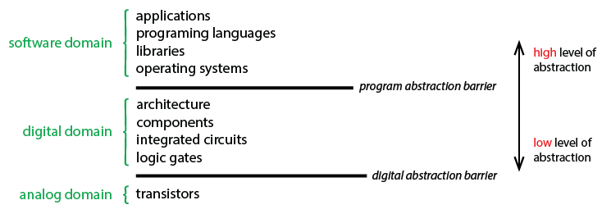

Slide 12
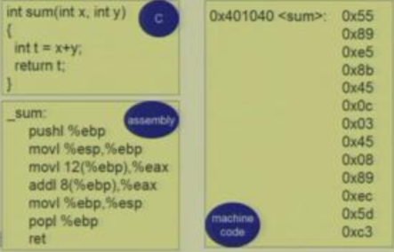
Abstraction in Software:
Notes:
compiler will take this program in C and produce an equivalent program
Assembler will convert assembly level language into Machine language

Slide 13
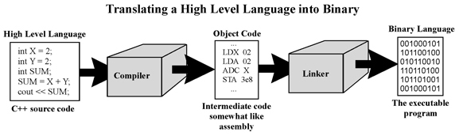
Abstraction in Software:

Slide 14
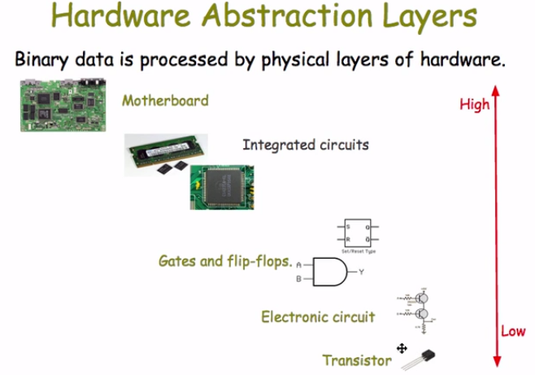

Slide 15
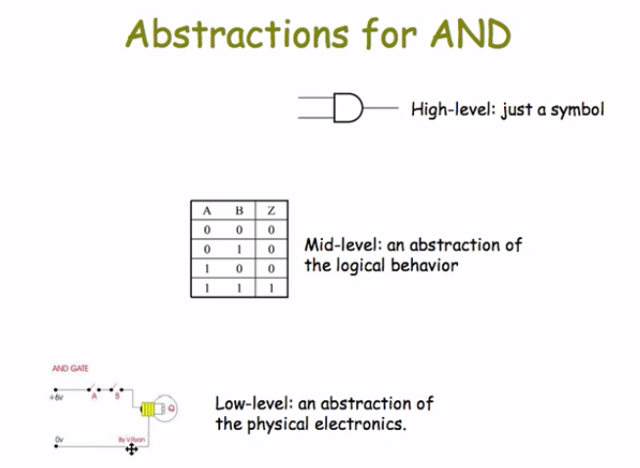

Slide 16
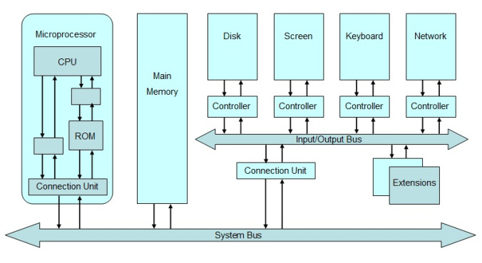
Hardware Abstraction:

Slide 17
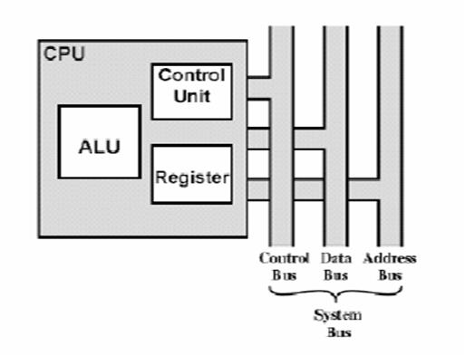

Slide 18
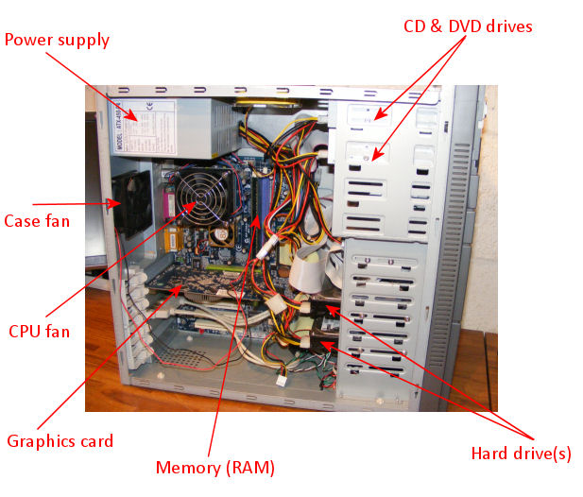

Slide 19
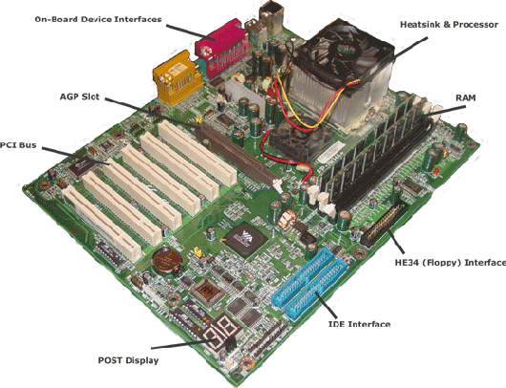

Slide 20
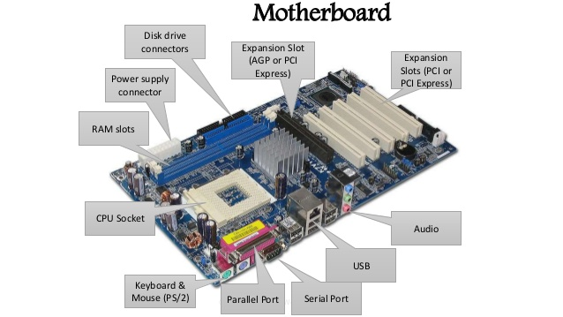

Slide 21
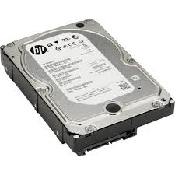
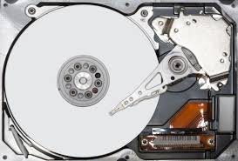

Slide 22
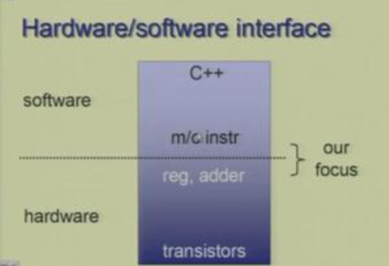

Slide 23
Architecture Levels:
Instruction Set Architecture (ISA)
Lowest Level visible to a programmer
Micro Architecture
Fills the gap between instructions and logic modules
Notes:
t is where you have a set of instructions which define the basic capability of a processor and major hardware components which are able to understand those instructions. So, if you are a programmer you will see the machine as defined by a set of instructio ns whereas if you are a hardware designer you will see software in terms of those machine instructions which you need to interpret.

Slide 24
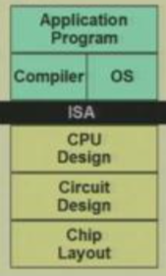
Logic modules for example, an ALU or a register file themselves do not define any instructions but the way they are put together, the way the information is made to flow through these is what defines instruction.

Slide 25
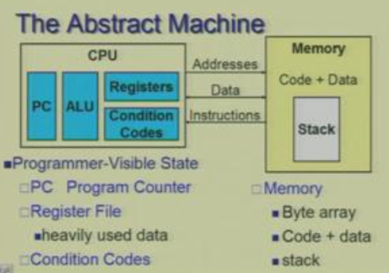

Slide 26
Architecture Levels Truth:
Int’s are not Integers, Float’s are not Real
You know Assembly (Chances in writing program in Assembly is very minimal.
However, understanding assembly is the key to machine-level execution model.
Memory Matters
Memory is not unbounded
Memory performance is not uniform
There’s more to performance than asymptotic complexity

Slide 27
Embedded Computers:
Processor as an Intelligent electronic component rather than processor as Computing Engine.
Real-time operation
Requires hardware-software Co-design
Highly Customized

Slide 28
Why different Processors?
What’s the difference between processors used in desktops, laptops, mobile phones, washing machine etc.?
Performance/Speed
Power Consumption
Cost
General Purpose/Special Purpose

Slide 29
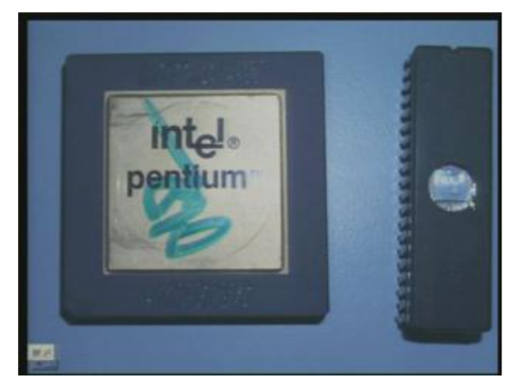

Slide 30


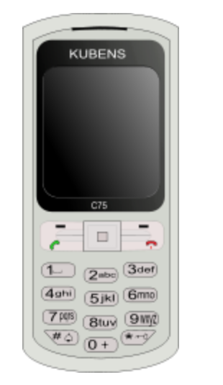
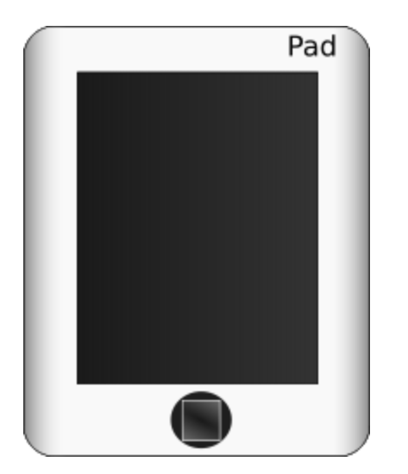
What is a Computer ?
A computer is a general purpose device that can be programmed to process
information, and yield meaningful results.
30

Slide 31
How does it work ?
Information
store
Program
Computer
results
Program – List of instructions given to the computer
Information store – data, images, files, videos
Computer – Process the information store according to the instructions in the program
31

Slide 32
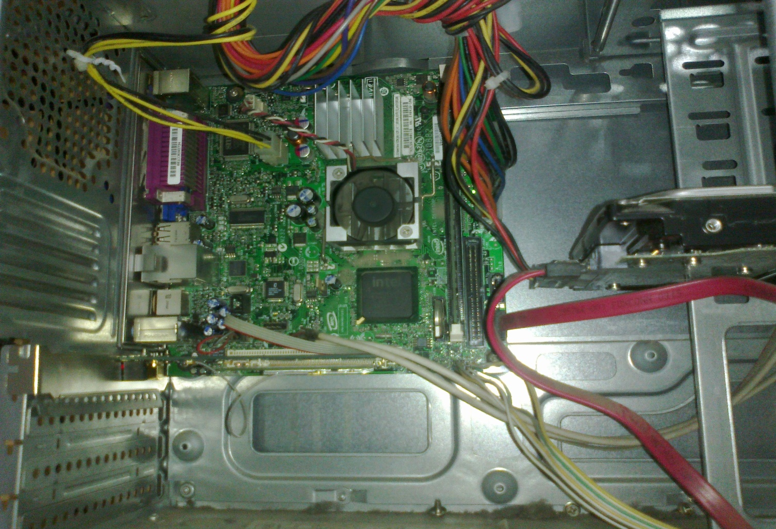
What does a computer look like ?
Let us take the lid off a desktop computer
CPU
Hard disk
Memory
32

Slide 33
Memory
Hard disk
Computer
Memory – Stores programs and data. Gets destroyed when the computer is powered off
Hard disk – stores programs/data permanently
33

Slide 34
Let us make it a full system ...
Memory
Hard disk
Computer
Keyboard
Monitor
Mouse
Printer
34

Slide 35
What is the most intelligent computer ?
35

Slide 36
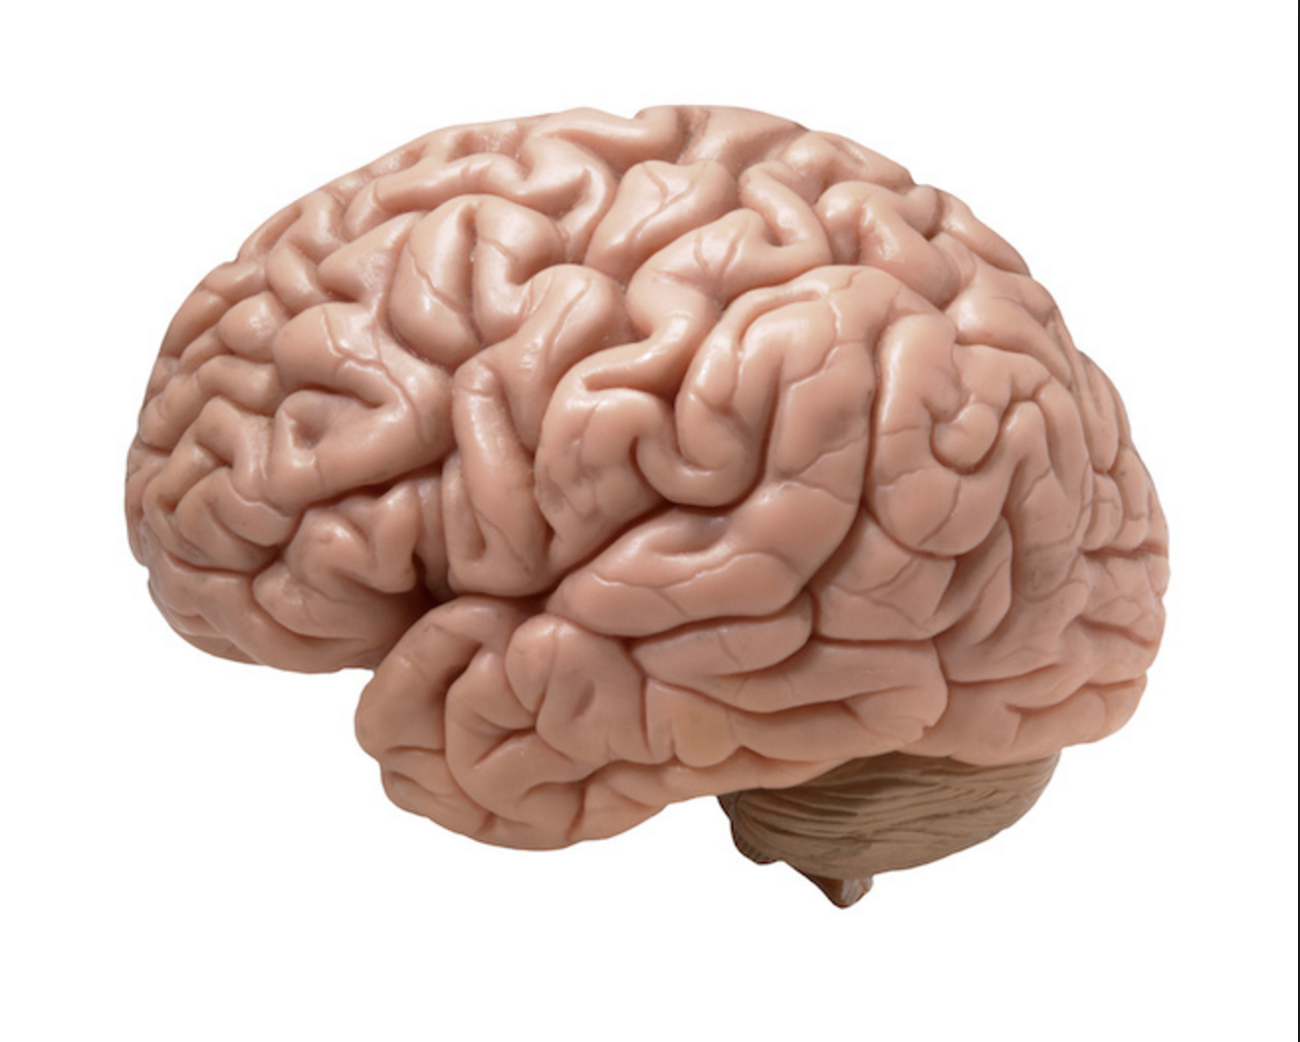
Answer ...
36

Slide 37
How does an Electronic Computer Differ from our Brain ?
Feature
Computer
Our Brilliant Brain
Intelligence
Dumb
Intelligent
Speed of basic calculations
Ultra-fast
Slow
Can get tired
Never
After sometime
Can get bored
Never
Almost always
Computers are ultra-fast and ultra-dumb
37

Slide 38
How to Instruct a Computer ?
compile
execute
Program
Executable
Output
Write a program in a high level language – C, C++, Java
Compile it into a format that the computer understands
Execute the program
38

Slide 39
What Can a Computer Understand ?
Computer can clearly NOT understand instructions of the form
Multiply two matrices
Compute the determinant of a matrix
Find the shortest path between Mumbai and Delhi
They understand :
Add a + b to get c
Multiply a * b to get c
39

Slide 40
The Language of Instructions
Humans can understand
Complicated sentences
English, French, Spanish
Computers can understand
Very simple instructions
The semantics of all the instructions supported by a processor is known
as its instruction set architecture (ISA). This includes the semantics of
the instructions themselves, along with their operands, and interfaces
with peripheral devices.
40

Slide 41
Features of an ISA
Example of instructions in an ISA
Arithmetic instructions : add, sub, mul, div
Logical instructions : and, or, not
Data transfer/movement instructions
Complete
It should be able to implement all the programs that users may write
41

Slide 42
Features of an ISA
Concise
The instruction set should have a limited size. Typically an ISA contains 32-1000 instructions.
Generic
Instructions should not be too specialized, e.g. add14 (adds a number with 14) instruction is too specialized
Simple
Should not be very complicated.
42

Slide 43
Designing an ISA
Important questions that need to be answered :
How many instructions should we have ?
What should they do ?
How complicated should they be ?
Two different paradigms : RISC and CISC
RISC
(Reduced Instruction Set
Computer)
CISC
(Complex Instruction
Set Computer)
43

Slide 44
RISC vs CISC
A reduced instruction set computer (RISC) implements
simple instructions that have a simple and regular
structure. The number of instructions is typically a small
number (64 to 128). Examples: ARM, IBM PowerPC,
HP PA-RISC
A complex instruction set computer (CISC) implements complex instructions that are highly irregular, take multiple operands, and implement complex functionalities. Secondly, the number of instructions is large (typically
500+). Examples: Intel x86, VAX
44

Slide 45
Takeaway Points..
Computers are dumb yet ultra-fast machines.
Instructions are basic rudimentary commands used to communicate with the processor. A computer can execute billions of instructions per second.
The compiler transforms a user program written in a high level language such as C to a program consisting of basic machine instructions.
The instruction set architecture(ISA) refers to the semantics of all the instructions supported by a processor.
The instruction set needs to be complete. It is desirable if it is also concise, generic, and simple.
45

Slide 46


Completeness of an ISA
How can we ensure that an
ISA is complete ?
Complete means :
Can implement all types of programs
For example, if we just have add instructions, we cannot subtract (NOT Complete)
46

Slide 47
Completeness of an ISA – II
How to ensure that we have just enough instructions such that we can implement every possible program that we might want to write ?
47

Slide 48
Answer
Let us look at results in theoretical computer science
Is there an universal ISA ?
Universal ISA
Universal Machine
The universal machine has a set of basic actions, and each such
action can be interpreted as an instruction.
48

Slide 49
The Turing Machine – Alan Turing
Known as the father of computer science
Discovered the Turing machine that is the most powerful computing device known to man
Indian connection : His father worked with the Indian Civil Service at the time he was born. He was posted in Chhatrapur, Odisha.
49

Slide 50
Turing Machine
Infinite Tape
L
R
State Register
Tape Head
The tape head can only move left or right
Action Table
(old state, old symbol) -> (new state, new symbol, left/right)
50
Notes:
https://www.youtube.com/watch?v=0bv5qe7jJUg

Slide 51
Operation of a Turing Machine
There is an inifinite tape that extends to the left and right. It consists of an infinite number of cells.
The tape head points to a cell, and can either move 1 cell to the left or right
Based on the symbol in the cell, and its current state, the Turing machine computes the transition :
Computes the next state
Overwrites the symbol in the cell (or keeps it the same)
Moves to the left or right by 1 cell
The action table records the rules for the transitions.
51

Slide 52
Example of a Turing Machine
Design a Turing machine to increment a number by 1.
$
7
3 4 6 9
$
Tape Head
Start from the rightmost position. (state = 1)
If (state = 1), replace a number x, by x+1 mod 10
The new state is equal to the value of the carry
Keep going left till the '$' sign
52

Slide 53
More about the Turing Machine
This machine is extremely simple, and extremely powerful
We can solve all kinds of problems – mathematical problems, engineering analyses, protein folding, computer games, …
Try to use the Turing machine to solve many more types of problems (TODO)
53

Slide 54
Church-Turing Thesis
Church-Turing thesis: Any real-world computation can be translated
into an equivalent computation involving a Turing machine.
(source: Wolfram Mathworld)
Note : It is a thesis, not a theorem
For the last 60 years, nobody has found a counter-example
Definition:
Any computing system that is equivalent to a Turing machine is said to be
Turing complete.
54

Slide 55
Universal Turing Machine
For every problem in the world, we can design a Turing Machine (Church-Turing thesis)
Can we design a universal Turing machine that can simulate any Turing machine. This will make it a universal machine (UTM)
Why not? The logic of a Turing machine is really simple. We need to move the tape head left, or right, and update the symbol and state based on the action table. A UTM can easily do this.
A UTM needs to have an action table, state register, and tape that can simulate any arbitrary Turing machine.
55

Slide 56
Universal Turing Machine
Prog. 1
Prog. 2
Prog. 3
Turing Machine 1
Turing Machine 2
Turing Machine 3
Universal Turing Machine
56

Slide 57
A Universal Turing Machine
Simulated State Register
Simulated Action Table
Work Area
L
R
Generic State Register
Tape Head
Generic Action Table
57

Slide 58
A Universal Turing Machine
Program Counter
(PC)
Instruction Memory
Simulated State Register
Data Memory
Simulated Action Table
Work Area
L
R
Generic State Register
Tape Head
CPU
Program
PC
Generic Action Table

Slide 59
Computer Inspired from the Turing Machine
Program
CPU
Program
Control
Arithmetic
Counter (PC)
Unit
Unit
Instruction
Program
Data
Memory
59

Slide 60
Elements of a Computer
Memory (array of bytes) contains
The program, which is a sequence of instructions
The program data → variables, and constants
The program counter(PC) points to an instruction in a program
After executing an instruction, it points to the next instruction by default
A branch instruction makes the PC point to another instruction (not in sequence)
CPU (Central Processing Unit) contains the
Program counter, instruction execution units
60

Slide 61
Let us now design an ISA ...
Single Instruction ISA
sbn – subtract and branch if negative
Add (a + b) (assume temp = 0)
1: sbn temp, b, 2
2: sbn a, temp, exit
61

Slide 62
Single Instruction ISA - II
Add the numbers – 1 … 10
Initialization:
one = 1
index = 10
sum = 0
1: sbn temp, temp, 2 // temp = 0
2: sbn temp, index, 3 // temp = -1 * index
3: sbn sum, temp, 4 // sum += index
4: sbn index, one, exit // index -= 1
5: sbn temp, temp, 6 // temp = 0
6: sbn temp, one, 1 // (0 - 1 < 0), hence goto 1
exit
62

Slide 63
Multiple Instruction ISA
Arithmetic Instructions
add, subtract, multiply, divide
Logical Instructions
or, and, not
Move instructions
Transfer values between memory locations
Branch instructions
Move to a new program location, based on the values of some memory locations
63

Slide 64
Designing Practical Machines
CPU
ALU
Data
Instruction
Control
memory
memory
I/O devices
Harvard Architecture
64

Slide 65
Von-Neumann Architecture
CPU
ALU
Memory
Control
I/O devices
65

Slide 66


Problems with Harvard/ Von-Neumann Architectures
The memory is assumed to be one large array of bytes
It is very very slow
Solution:
Have a small array of named locations (registers) that can be used by instructions
This small array is very fast
General Rule: Larger is a structure, slower it is
Insight: Accesses exhibit locality (tend to use the same
variables frequently in the same window of time)
66

Slide 67
Uses of Registers
A CPU (Processor) contains set of registers (16-64)
These are named storage locations.
Typically values are loaded from memory to registers.
Arithmetic/logical instructions use registers as input operands
Finally, data is stored back into their memory locations.
67

Slide 68
Example of a Program in Machine Language with Registers
1: r1 = mem[b] // load b
2: r2 = mem[c] // load c
3: r3 = r1 + r2 // add b and c
4: mem[a] = r3 // save the result
r1, r2, and r3, are registers
mem → array of bytes representing memory
68

Slide 69
Machine with Registers
CPU
Registers
ALU
Memory
Control
I/O devices
69

Slide 70

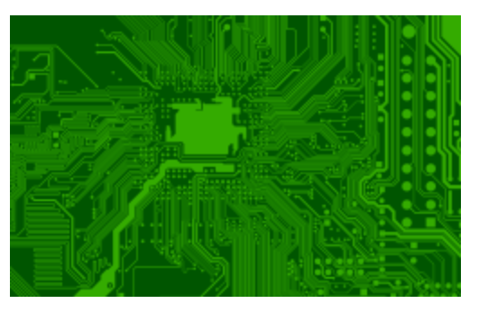
Where are we ...
We have derived the structure of a computer from theoretical fundamentals.
It has a CPU with a program counter & registers, memory, and peripherals.
The Instruction Set Architecture (ISA) is the link between hardware and software.
Instruction
Set
Architecture
70

Slide 71
Instruction Set Architecture
Interface between software and hardware
A compiler converts a program into machine instructions in the given ISA
The processor executes the instructions in the ISA
We shall first look at the software aspect of the ISA (assembly programs)
Then look at implementing the ISA by designing the processor
Then, we shall make the computer more efficient by designing fast memory/ storage systems
71

Slide 72
THE END
72

